Slide 1

EVENT MANAGEMENT
SYSTEM

Slide 2
DONE BY
NAME | USN
RADHIKADEVI | 2BV12IS046
MAHESH | 2BV13IS411
VAISHALI PIPPAL | 2BV12IS118
V.MOUKTHIKA | 2BV12IS120
UNDER THE GUIDANCE OF
MRS NAMRATA D HIREMATH

Slide 3
EXISTING SYSTEM
Going to their respective hotels/halls and checking the availability of halls which requires tedious work.
DRAWBACKS :
Time wastage
Energy wastage
Resource wastage
The traditional system which is followed, is ‘Help from the relatives or friends’. They play a vital role in guiding us with the halls.
There are many DISCRETE websites for booking halls and searching for the lodges nearby.
There is no app that provides with booking of the hall and guiding users with the lodges near by the hall.

Slide 4

MOTIVATION
Considering the factors of the existing system, it has motivated us to design this system.
Function hall is such a place which re-unites the family to brush up there old and beautiful memories. Marking this as a benchmark issue, we have planned to design an app that fulfills all the requirements essential for the client as there is no acknowledgement for this type of software.
this motivated us to design this system.
Function hall is such a place which re-unites the family to brush up there old and beautiful memories. Marking this as a benchmark issue, we have planned to design an app that fulfills all the requirements essential for the client as there is no acknowledgement for this type of software.

Slide 5
PROBLEM STATEMENT
To Design a system for booking /cancellation of the banquet halls/hotels for social events and also guides the users with the details of nearby accomodation.

Slide 6
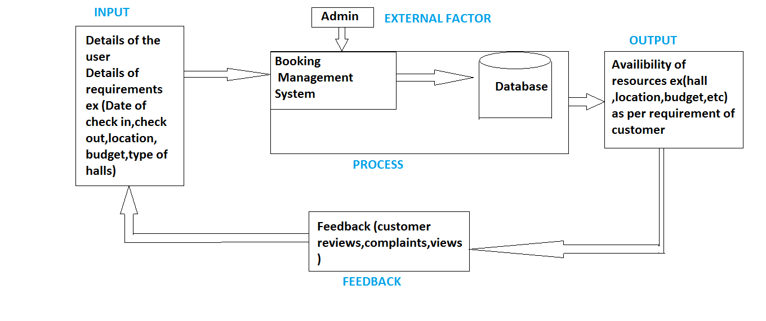
PROCESS MODEL

Slide 7
FUNCTIONALITIES
IF A USER LOGIN
BOOKING (RESERVATION)
CANCELLATION
CHECK STATUS
SEARCH
IF AN ADMIN LOGINS
UPDATING SYSTEM
ADDING NEW HOTELS
DELETING PREVIOUS ONES
ADDING NEW FUNCTIONALITIES (According to customer need, client need)
CHECKING REGISTERED USERS AND THEIR INFORMATION STORED IN THE
DATABASE
CHECKING AVAILIBILTY OF HOTELS

Slide 8
Concepts Relevance
COURSE | CONCEPTS USED
DBMS | CRUD OPERATIONS(create,read,update delete)
JAVA | Httpclient,post,request,linking java and php
PHP | Jsonparser,inserting,deleting
XML | Designing layout

Slide 9



Slide 10


